Slide 1

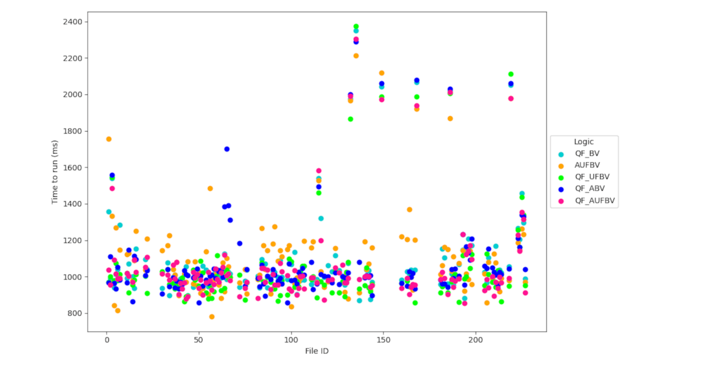
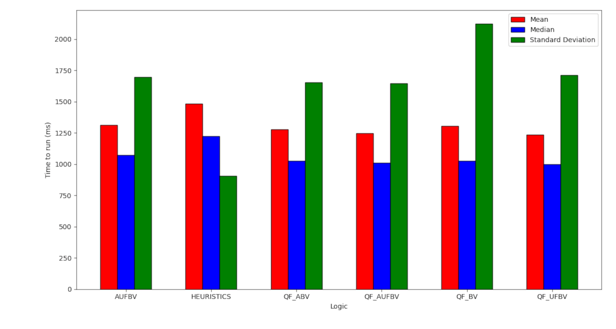
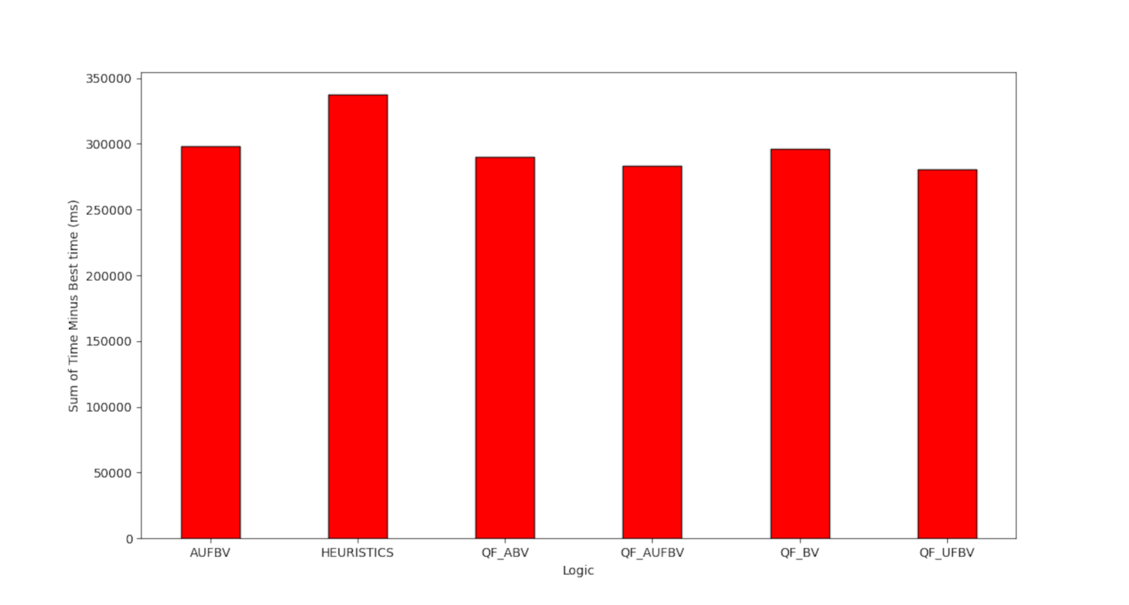
The effect of SAT logics in Faial
Austin Guiney and Tiago Cogumbreiro
Background
Efficient detection of data-race bugs in Faial makes software safer and more reliable.
Computer bug detection in GPU programs can be improved by selecting optimal parameters in Faial.
Parameter selection algorithm:
Run AUFLIRA with a 2 second timeout.
Run QF_AUFBV on timeout.
Graphs
Methods
Data was collected by benchmarking the Faial program, which detects
data-race bugs in CUDA kernels.
Data visualization was used to interpret the data.
Fig 1. Visualization of the raw data that was collected.
Results
2 parameters were identified as optimal.
A parameter selection algorithm improves on the best parameter, as measured by the number of correct answers (206 vs 205).
Fig 2. Execution time statistics for Faial using different parameters.
Acknowledgements
The work of AG was supported in part by College of Science and Mathematics Dean’s Undergraduate Research Fellowship through fellowship support from Oracle, project ID R20000000025727.
This material is based upon work supported by the National Science Foundation under Grant No. 2204986.
This work was supported in collaboration with the Software Verification Lab.
Fig 3. Total execution time for Faial using different parameters.

